Slide 1
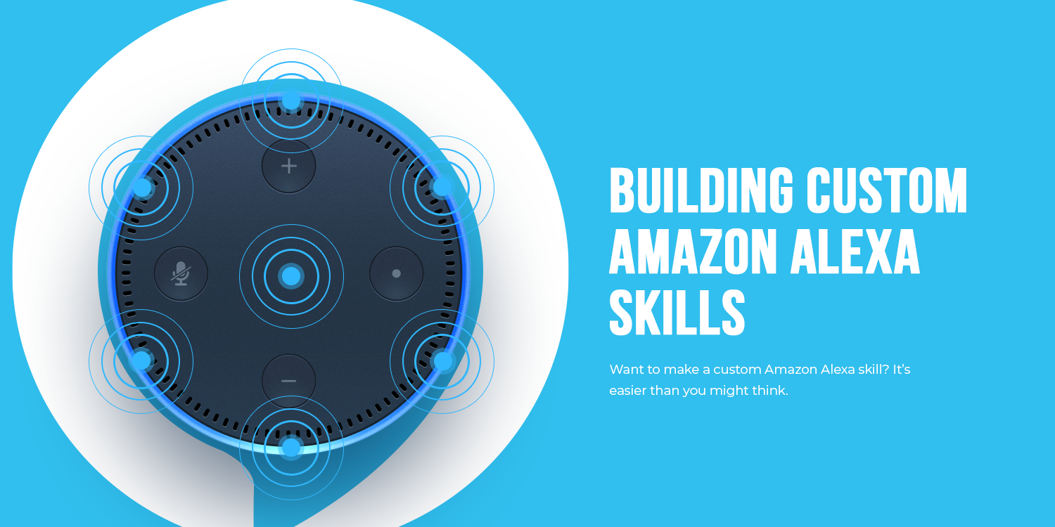

Slide 2




Who am I?
Tiffany Ford
Educator | Developer | Project Manager | Maker | Techie People Person

Slide 3
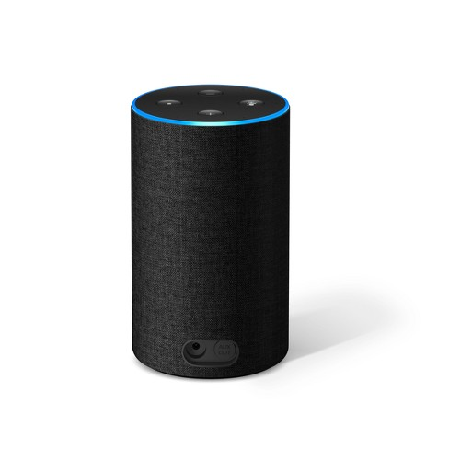
What is Alexa and what can she do?
Assistant for amazon echo
Allows for hands-free requests for information
Controls smart home devices
Integration with web services
App for phones
Alexa in your car?

Slide 4
What are skills?
Cloud-based services that you can access through Alexa
Different types of skills require different services
Services can be:
AWS Lambda functions
Web services hosted elsewhere (such as Azure)
Notes:
For a skill that controls smart home devices such as lights, thermostats, and entertainment devices you can use the Smart Home Skill API. In this case, you develop an AWS Lambda function that accepts device directives from Alexa:
You provide code to handle directives in an AWS Lambda function.
Your skill receives requests in the form of device directives to control a particular device. Your code then handles the request appropriately (for example, by turning on the requested light or turning up the volume).
All voice interactions with the user are handled by the Smart Home Skill API. You don't need to define the words users say to use the skill.
For a skill that controls video content you can use the Video Skill API. In this case, you develop a lambda function that accepts device directives from Alexa:
You provide code to handle directives in an AWS Lambda function.
Your skill receives requests in the form of device directives to control a video service. Your code then handles the request appropriately (for example, by playing a movie).
All voice interactions with the user are handled by the Video Skill API. You don't need to define the words users say to use the skill.
For a skill that provides content such as news, lists, or comedy for a customer's flash briefing, you can use the Flash Briefing Skill API. In this case, you create the skill in the developer console and configure one or more JSON or RSS feeds that contain the content:
To receive your content as a part of their flash briefing, a customer enables your flash briefing skill in the Alexa app, and turns on one or more content feeds.
All voice interactions with the user are handled by the Flash Briefing Skill API. You don't need to define the words users say to use the skill.
You supply one or more reliable content feeds in RSS or JSON format. The content can be audio content that Alexa plays to the customer, or text content that Alexa reads to the customer. You should own the content or have the rights to distribute it

Slide 5
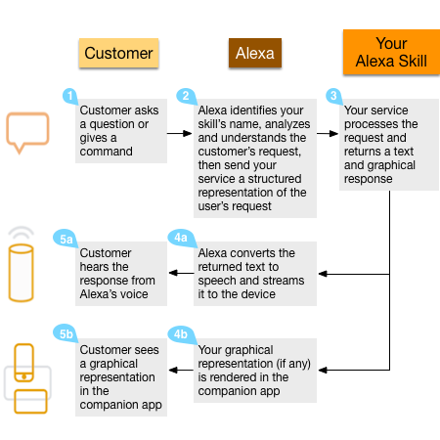

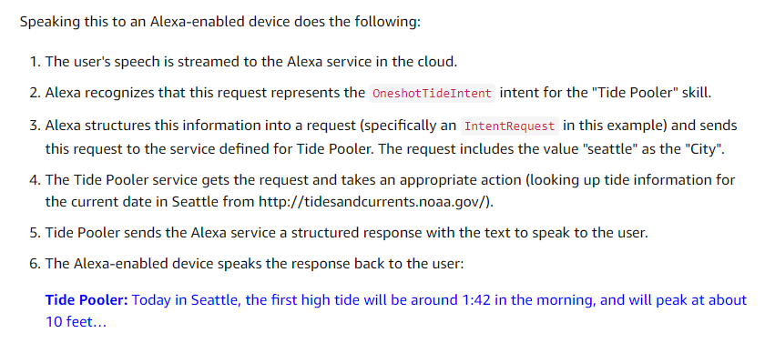
How does it work?

Slide 6
Anatomy of a Skill
Voice User Interface
Invocation Name
Intent(s)
Utterances
Music
Images
Video Files
Technical Capability
Notes:
A set of intents that represent actions that users can do with your skill. These intents represent the core functionality for your skill.
A set of sample utterances that specify the words and phrases users can say to invoke those intents. You map these utterances to your intents. This mapping forms the interaction model for the skill.
An invocation name that identifies the skill. The user includes this name when initiating a conversation with your skill.
If applicable, a set of images, audio files, and video files that you want to include in the skill. These must be stored on a publicly accessible site so that each item is accessible by a unique URL.
TECHNICAL ASPECTS:
Designing for Voice is very different than designing for screen. We should not think its flow, interaction with user like we think while developing mobile app or website. Instead the best way to design for Alexa skill is to just to practice real conversation like Alexa Skill will initiate when user will tell “this” invocation sentence then what will be response of Alexa and so on.

Slide 7
What do you need?
Access to Amazon Developer Console (developer.amazon.com)
Endpoint for your Alexa Skill (such as Lambda)
IDE for the language of your choice
You can author a Lambda function in Node.js, Java, Python, C#, or Go.
You can author a web service in any language appropriate for web services.

Slide 8
Making Your Own Skill in C#
Step #1 – Set up your skill in the Developer Portal
https://developer.amazon.com/

Slide 9
Making Your Own Skill in C#
Step #2 – Create your Alexa Skill in AWS Lambda
http://aws.amazon.com/

Slide 10
Making Your Own Skill in C#
Step #3 – Connect your Lambda function to your Skill
Copy the skill ID from the Developer Console into the Skill ID input box in the Configure triggers section of the Lambda function page

Slide 11
Making Your Own Skill in C#
Step #4 – Connect your Voice User Interface to your Lambda Function

Slide 12
Making Your Own Skill in C#
Step #5 – Code the Lambda Function

Slide 13
Making Your Own Skill in C#
Step #6 – Test
Use the Test pane in the Developer Portal to work with the Alexa Simulator

Slide 14
That’s It!
Once you’re done testing you can publish
Complete the Deployment information in the Developer Console
Wait for Amazon to test and approve

Slide 15
Further Info
Dr. Tiffany Ford
rhysma@gmail.com
www.tiffanyford.dev
Watch me build the Alexa Skills live on Twitch: https://www.twitch.tv/legendofrhysma/
Get the code: https://github.com/rhysma
Twitter: @TheRhysma

